Slide 1
GEOG-G489/589 Python Programming
Instructor: Natasha MacBean
Statistical Analyses

Slide 2
Statistical, scientific computing and machine learning libraries in Python
Three main modules for any kind of statistical analysis in python:
1. Scipy: https://www.scipy.org/about.html; https://docs.scipy.org/doc/scipy/reference/py-modindex.html
Scipy Stats: https://docs.scipy.org/doc/scipy/reference/tutorial/stats.html#; https://docs.scipy.org/doc/scipy/reference/stats.html#module-scipy.stats
2. StatsModels: https://www.statsmodels.org/stable/index.html
3. scikit-learn: https://scikit-learn.org/stable/index.html

Slide 3
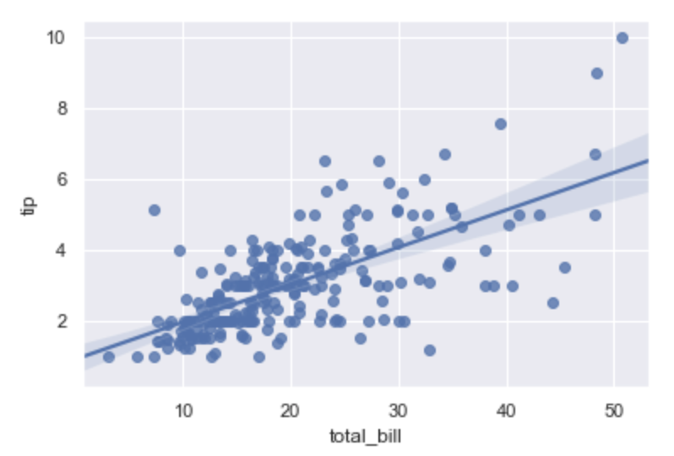
Today we’ll focus on linear regression
AIM: Fit a linear relationship to the data of the form:
y = mx + c
m = slope
c = intercept
Can estimate residual errors, correlation (R) and R², which is how much of the variance in the data is explained
Can also calculate significance using various test statistics such as t-test, f-tests and associated p-values.

Slide 4
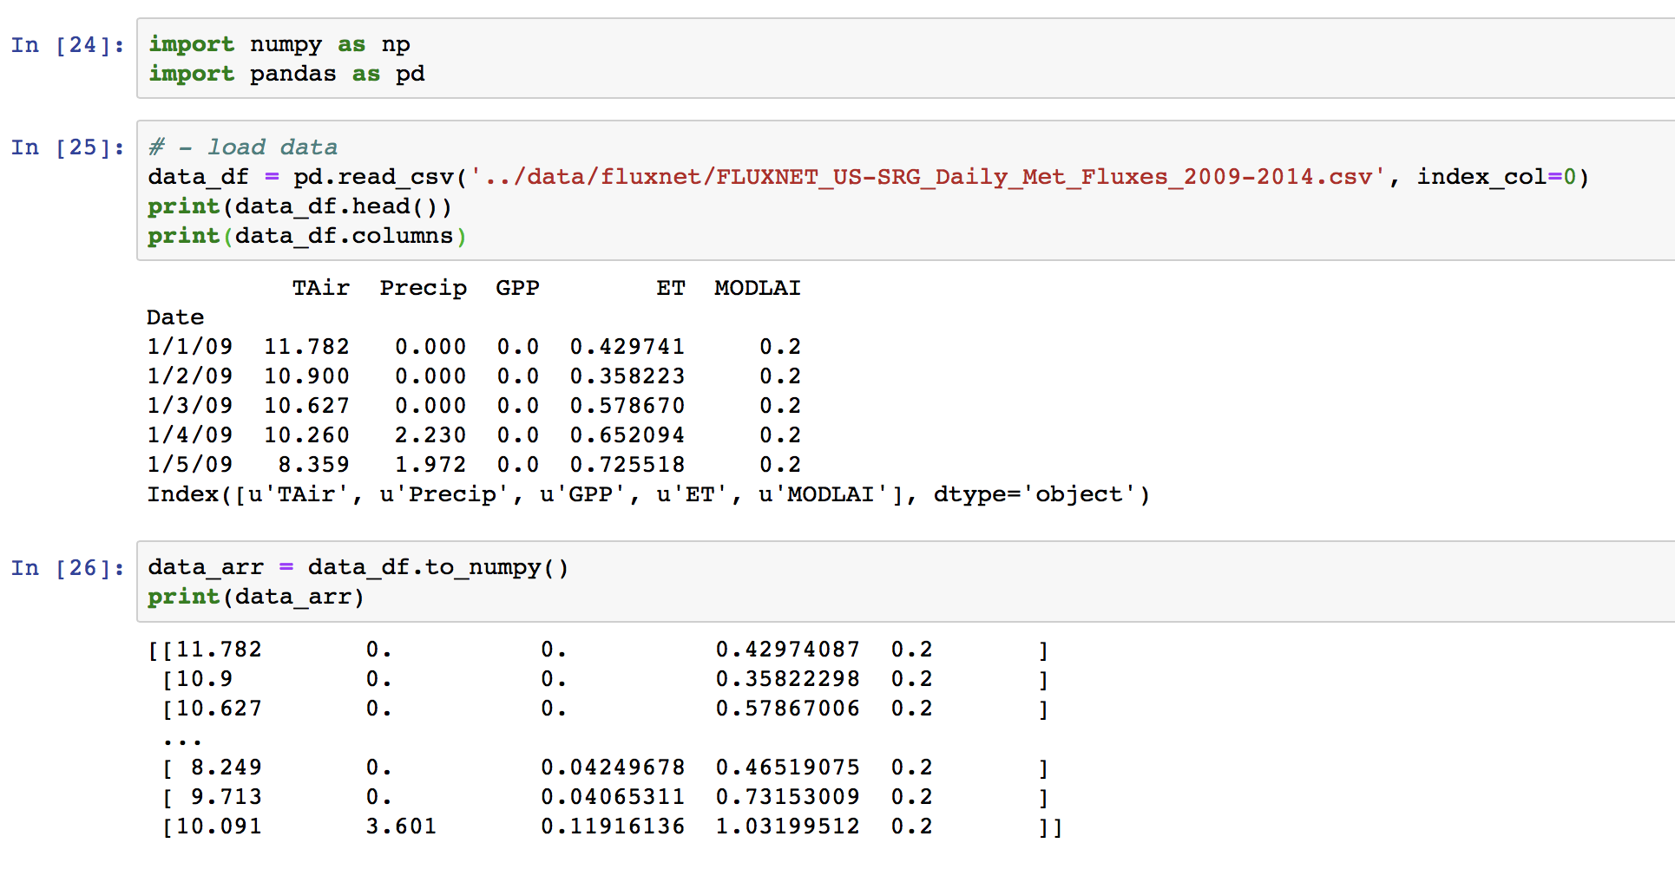
Today’s Data: flux tower Meteorological and Flux data

Slide 5
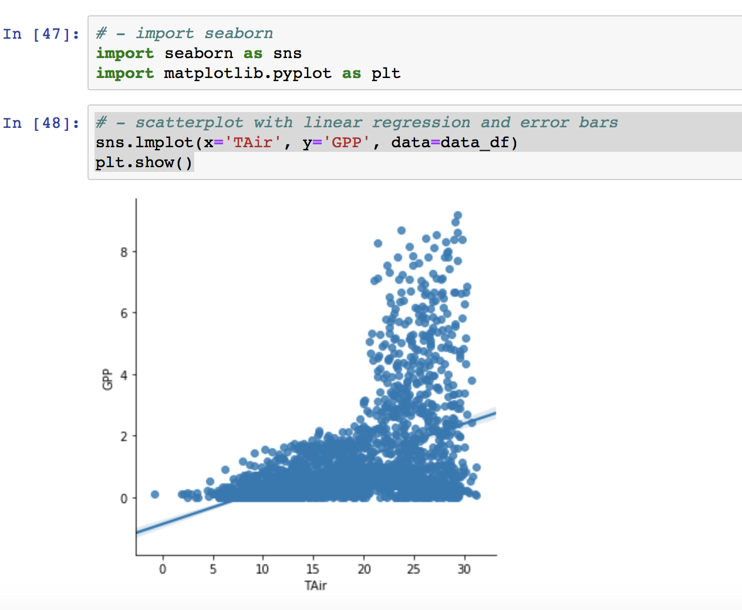
Linear regression with Seaborn (only for visualization)
https://seaborn.pydata.org/tutorial/regression.html#regression-tutorial

Slide 6
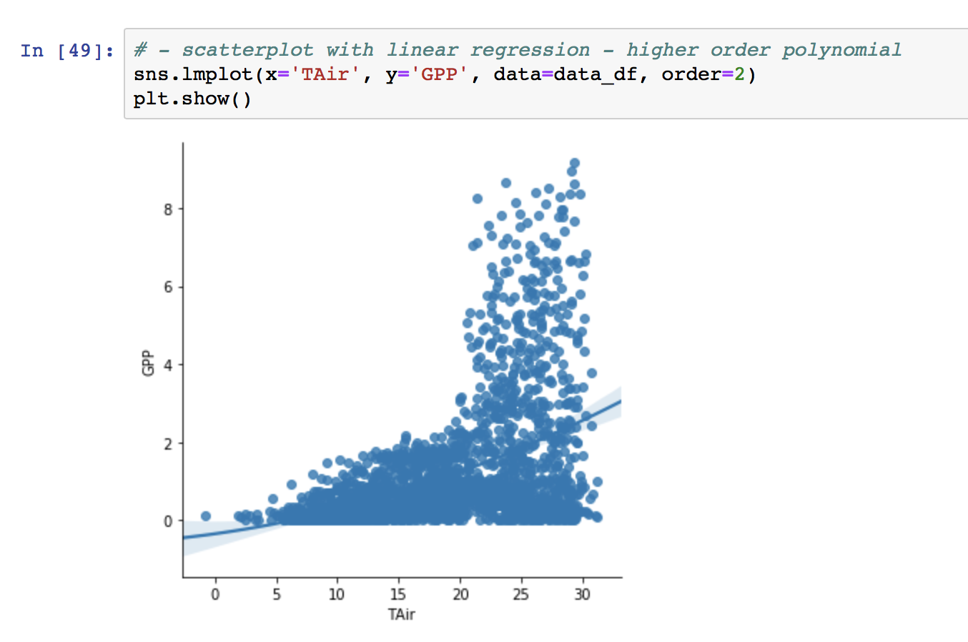
Linear regression with Seaborn (only for visualization)

Slide 7
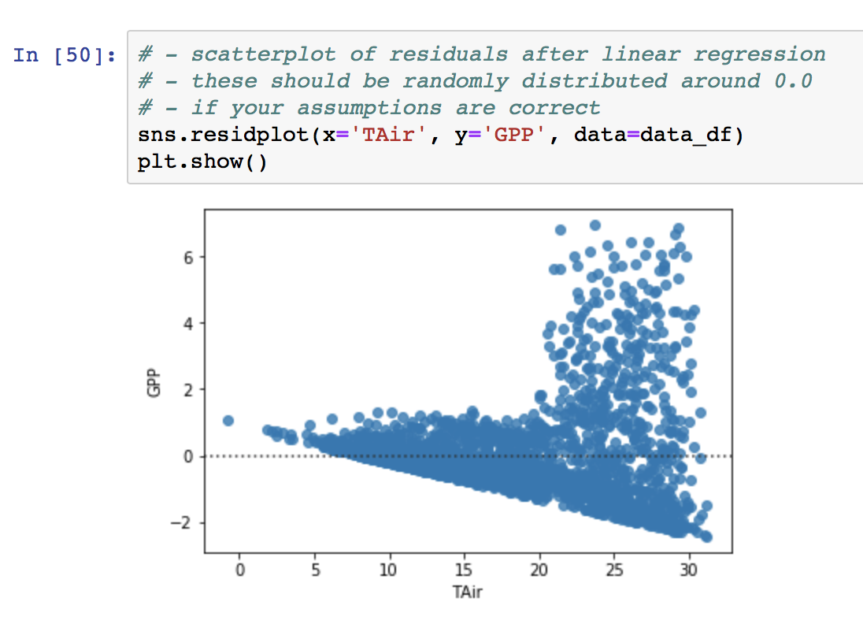
Linear regression with Seaborn (only for visualization)

Slide 8
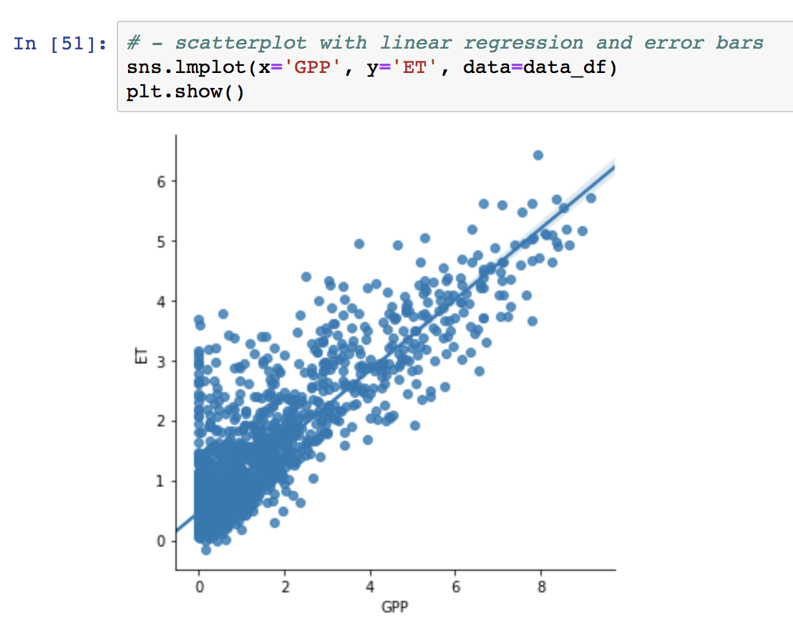
Linear regression with Seaborn (only for visualization)
GPP and ET have more of a linear relationship – though it’s not perfect. We will use this for demonstration purposes today.

Slide 9
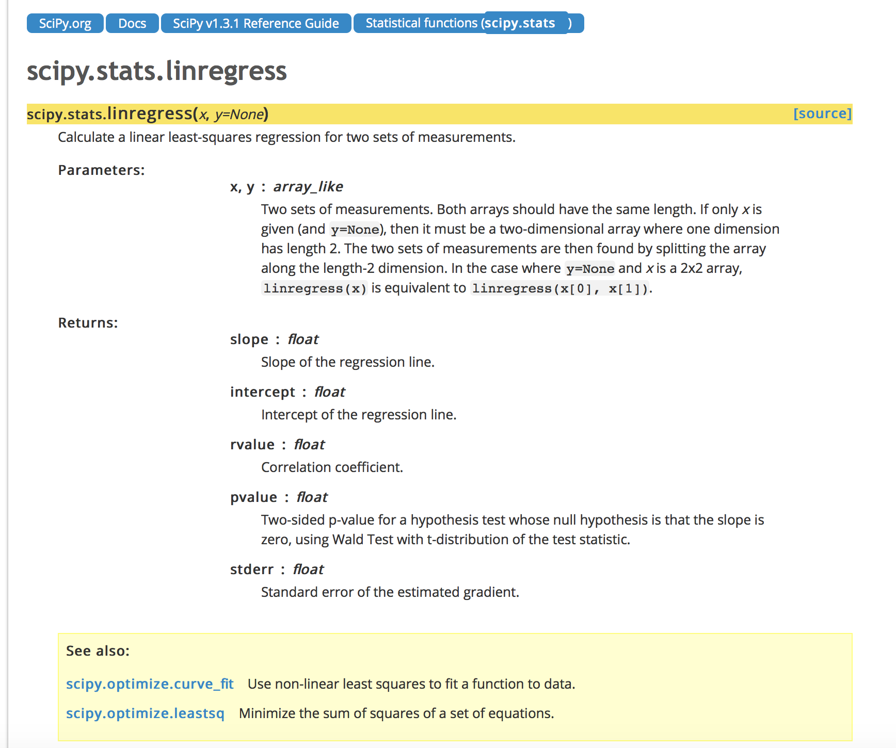
Linear regression with Scipy
https://docs.scipy.org/doc/scipy/reference/generated/scipy.stats.linregress.html#scipy.stats.linregress

Slide 10
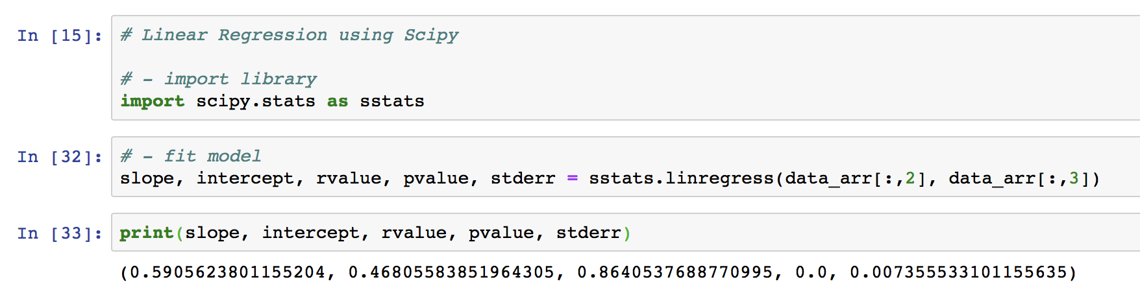
Linear Regression with Scipy
GPP
ET

Slide 11
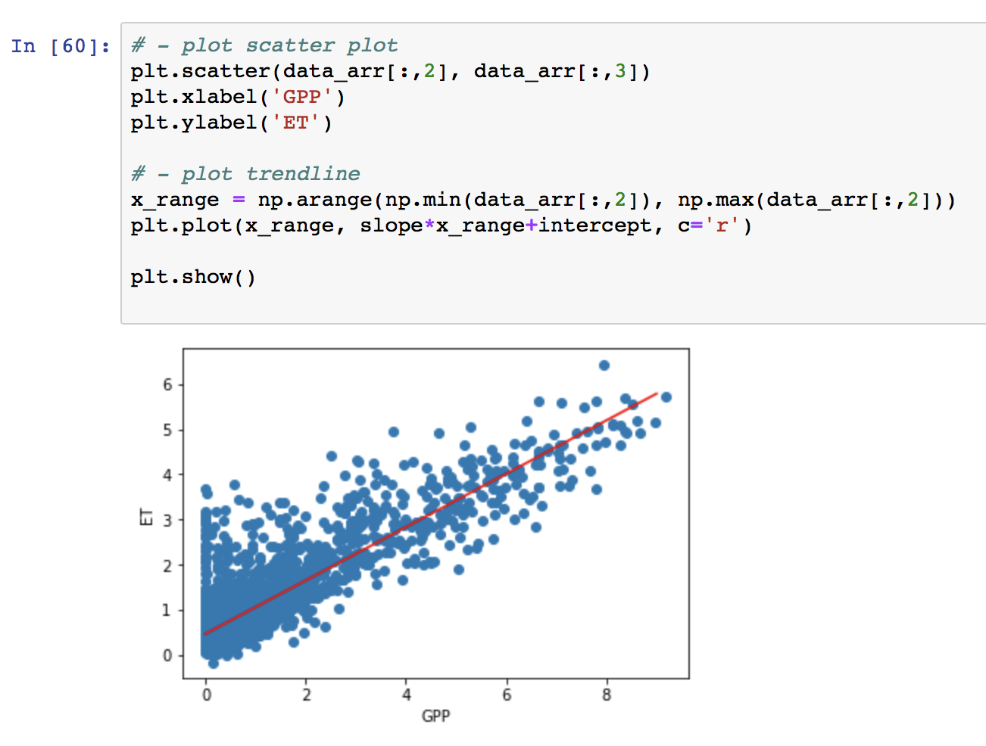
Linear Regression with Scipy

Slide 12
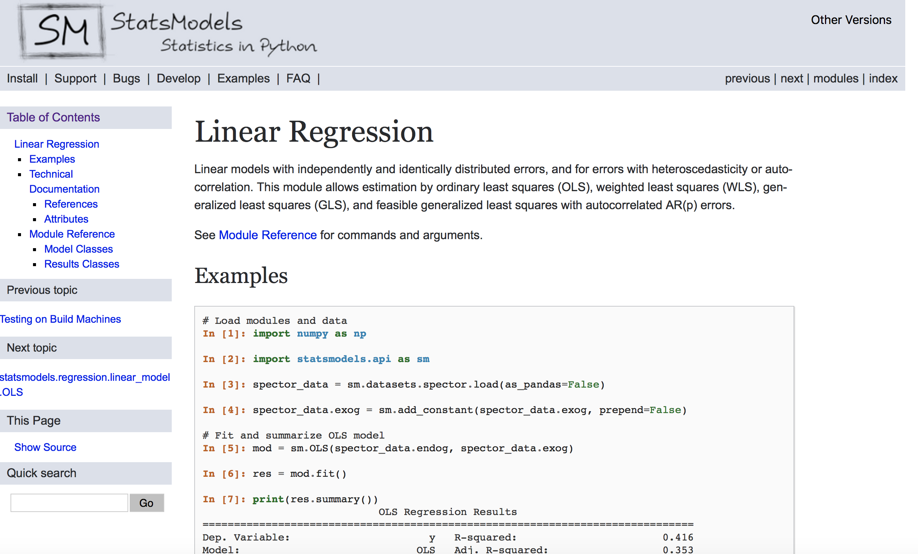
Linear regression with Statsmodels

Slide 13
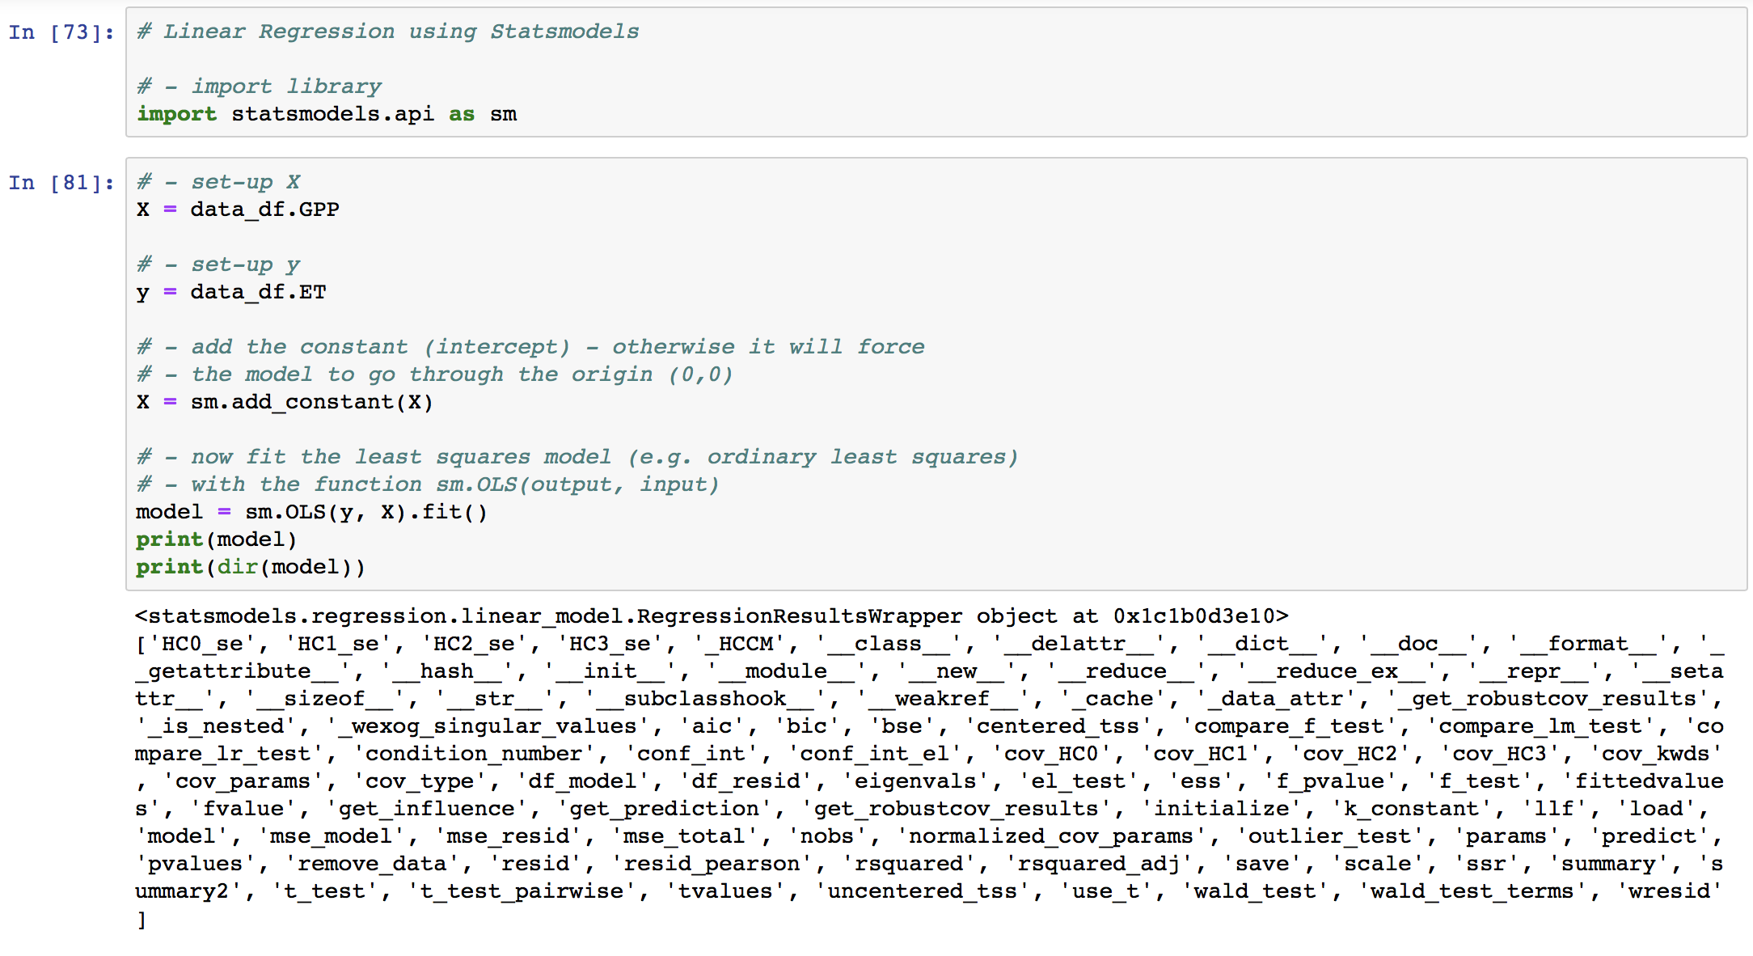
Linear regression with Statsmodels
Notes:
https://dbader.org/blog/meaning-of-underscores-in-python

Slide 14
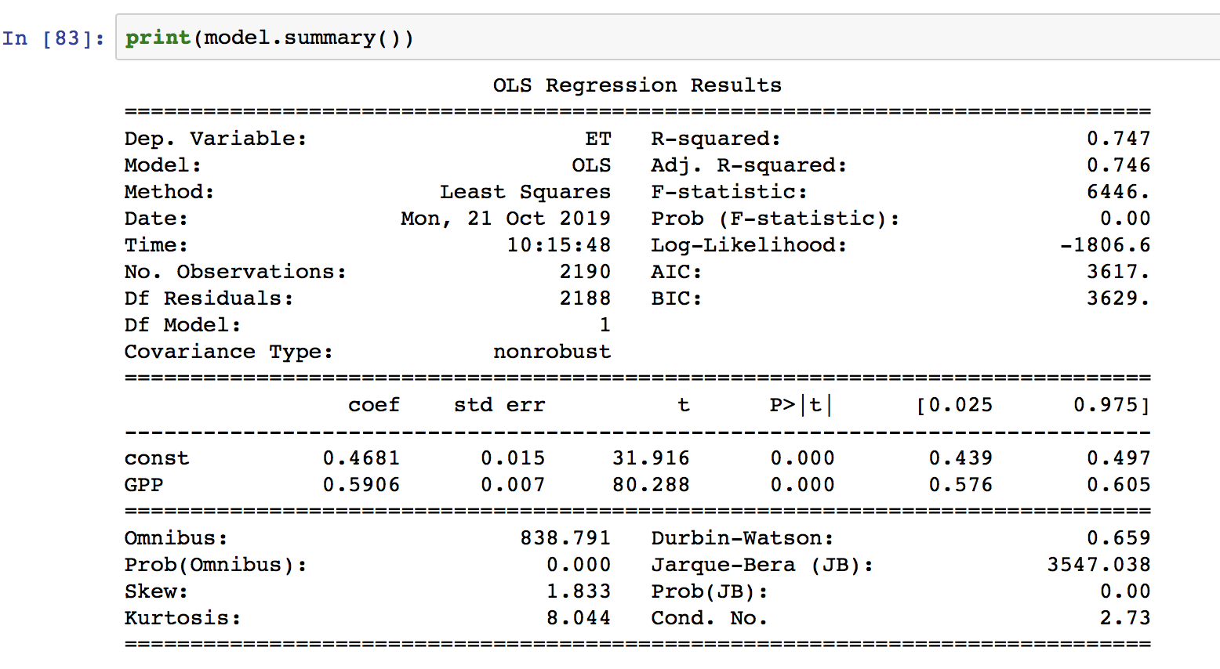
Linear regression with Statsmodels

Slide 15
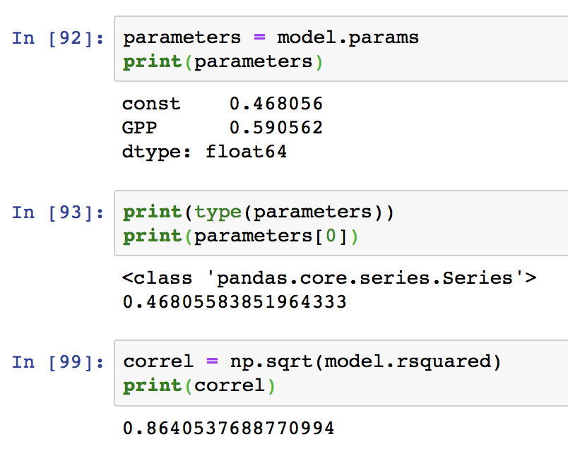
Linear regression with Statsmodels

Slide 16
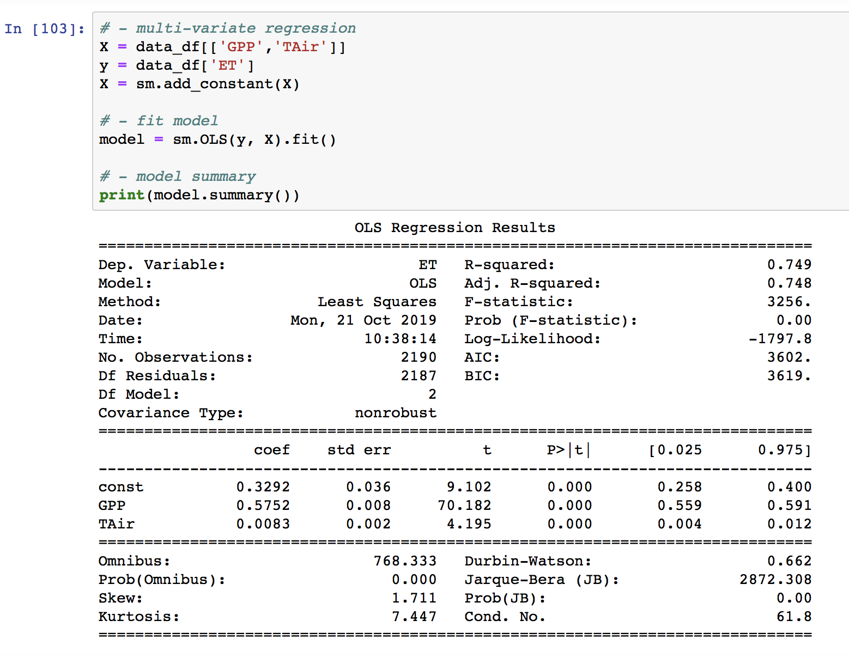
Multivariate linear regression with Statsmodels

Slide 17
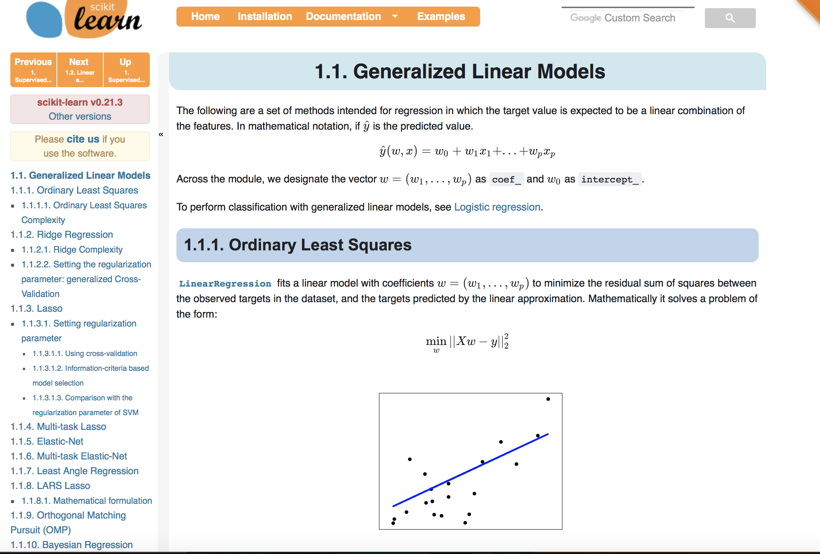
Linear Regression with Scikit-learn

Slide 18
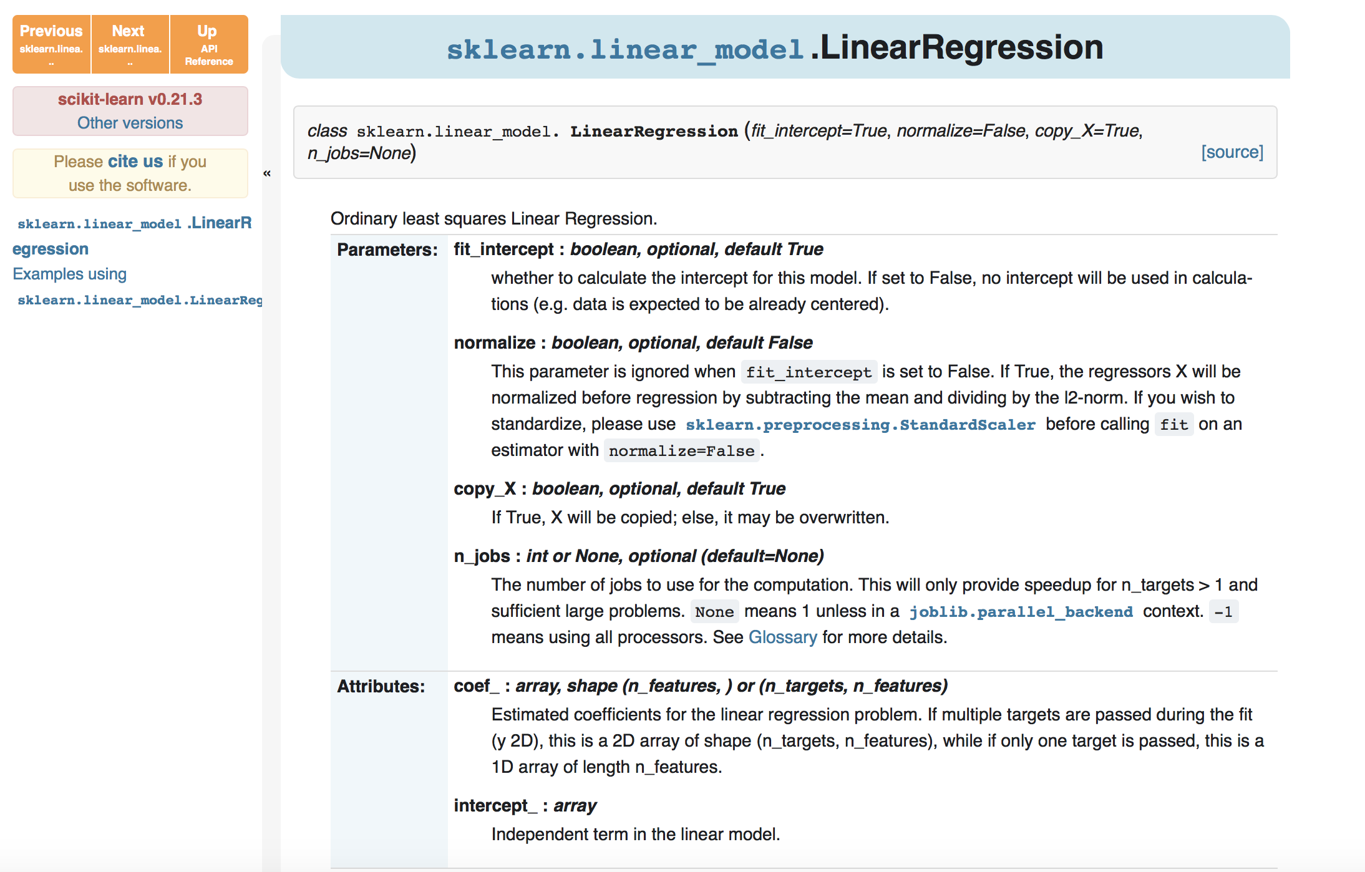
Linear Regression with Scikit-learn

Slide 19
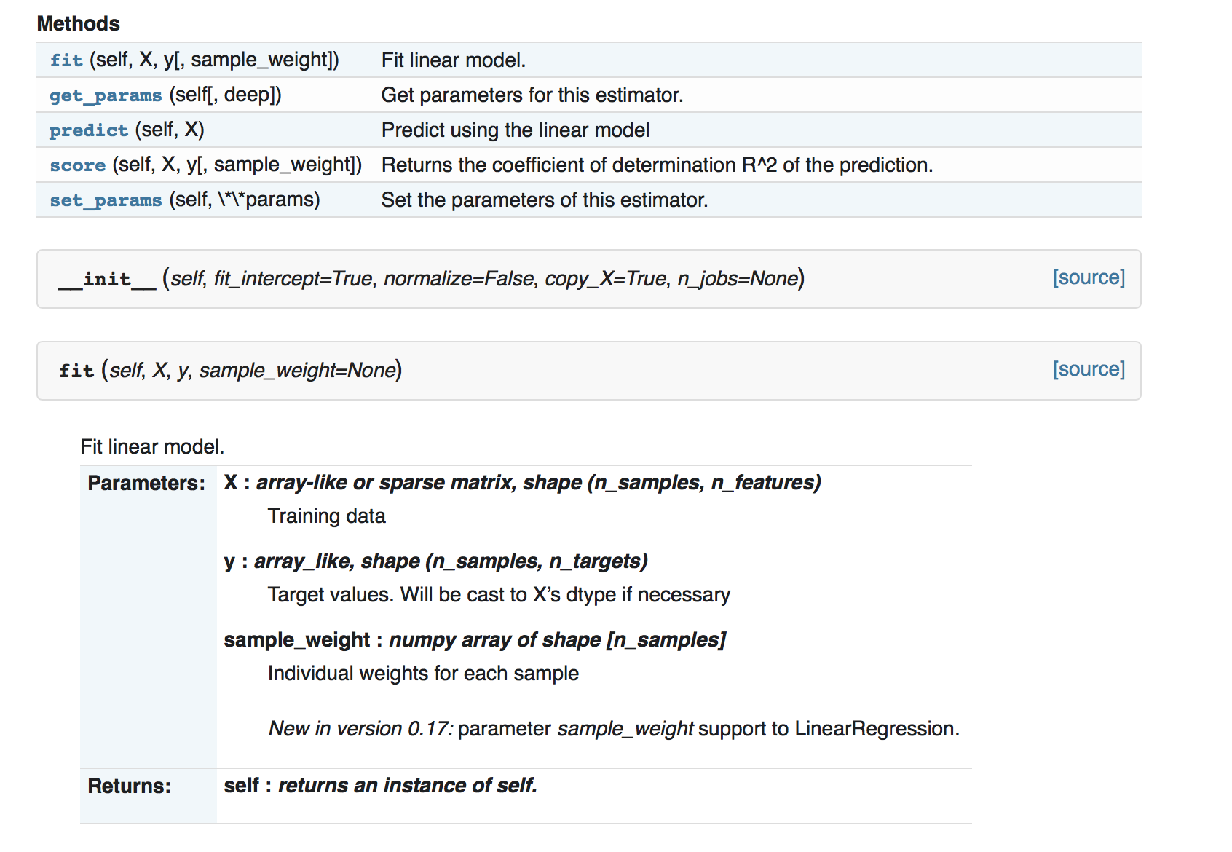
Linear Regression with Scikit-learn

Slide 20
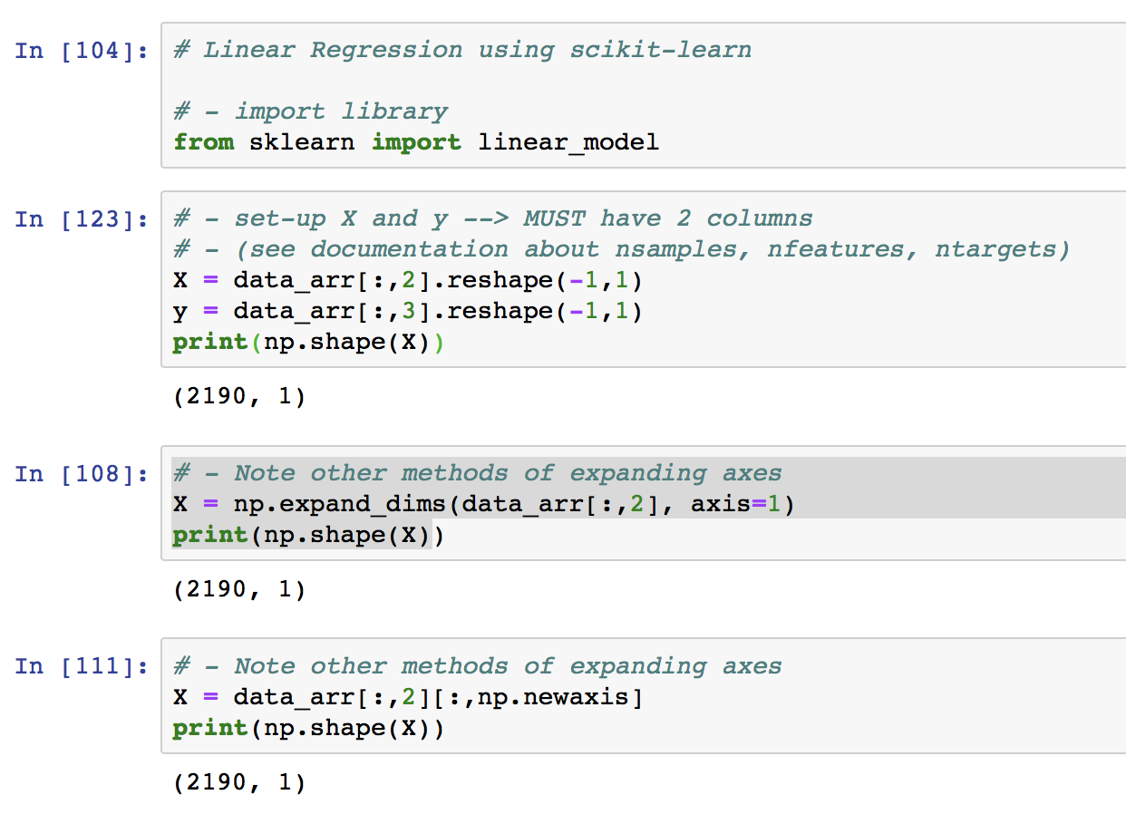
Linear Regression with Scikit-learn

Slide 21
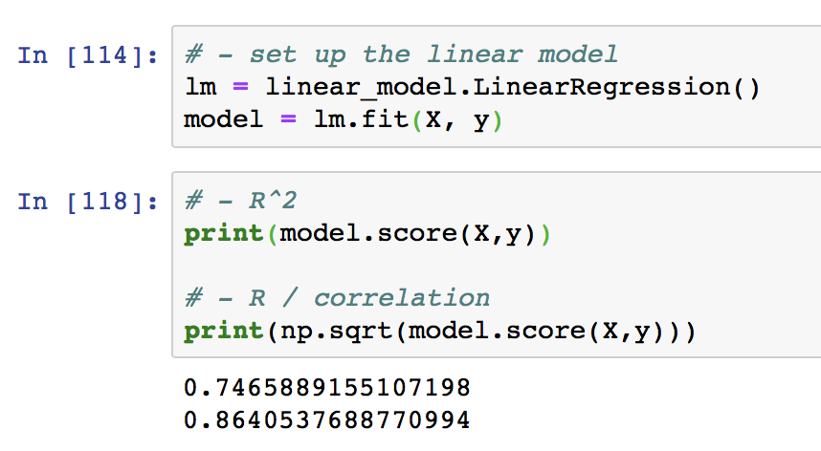
Linear Regression with Scikit-learn

Slide 22
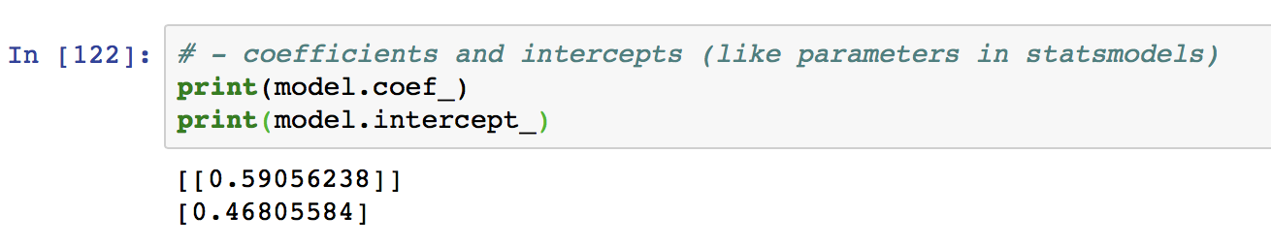
Linear Regression with Scikit-learn

Slide 23
Homework
DataCamp Module “Introduction to Linear Modeling in Python”:
https://www.datacamp.com/courses/introduction-to-linear-modeling-in-python
Two other chapters that could be useful:
2nd chapter of Supervised Learning with scikit-learn: Regression: https://www.datacamp.com/courses/supervised-learning-with-scikit-learn
4th chapter of Exploratory Data Analysis in Python: Multivariate Thinking: https://www.datacamp.com/courses/exploratory-data-analysis-in-python (at least first few sections)

